Slide 1
Ordering Processing
LUNAR PROJECT

Slide 2
Here we are,….
Keri Wisnu Nurhidayat | 1103120018
Putri Febri Yanti | 1103120022
Ryan Rynaldo | 1103120167
Alwan M Ubaidillah Al-Fath | 1103124293

Slide 3
What is The Ordering Processing?
An order processing system captures order data from customer service employees or from customers directly, stores data in a central database and sends order information to the accounting and shipping department if applicable.
acceptance of the order from the customer
customer has received the products
determined that order has been delivered accurately and completely.
The processing procedure
CUSTOMER SATISFACTION

Slide 4
Customers may place orders by submitting a written request, by phone, or by using online order forms that are routed directly to the seller. Each order is then routed to a distribution center, where the type and quantity of items requested by the customer are collected and prepared for shipping. In order to facilitate this process, larger companies often operate multiple distribution centers that are strategically located, allowing for the shipment to be delivered to the customer as soon as possible.

Slide 5
Once the order is received, the customer completes the order processing by inspecting the items that are delivered. If the items are in fact what the customer ordered, and are not damaged in any way, then the order processing cycle is considered complete. Should the received items be incorrect, or are damaged in any way, then the processing is not considered complete until the issues are resolved.

Slide 6
Advantages
Having a solid order processing system in place creates a win-win situation for businesses and their customers.
Customers experience more reliable deliveries and accurate order fulfillment.
Businesses can maximize their profitability by not misplacing or misreading orders, not to mention the long-term revenue boost that comes from consistently satisfying customers.

Slide 7
Disadvantages
Highly technological order processing systems can be costly to implement and maintain, possibly requiring additional information technology personnel to ensure that the system functions smoothly at all times.
Technological solutions are generally hands-off in nature, since a large number of processes occur in the background of software programs, requiring no input from employees.
Because of this, however, it can be much more difficult to track down problems in technology-driven systems than with simpler, manual systems where an employee can personally recall each step in the process.

Slide 8
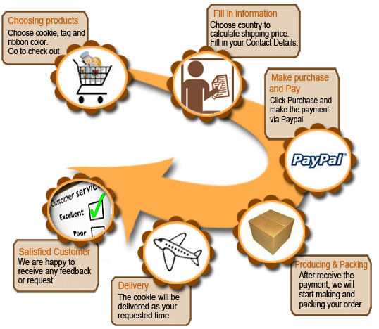
Place Your Topic Here
Your Description Goes Here

Slide 9
Source
http://www.bridalcookie.com/wedding-cookies/wp-content/uploads/2009/09/order-process.jpg
http://www.wisegeek.com/what-is-order-processing.htm
http://smallbusiness.chron.com/definition-order-processing-systems-3197.html

Slide 10
THANK YOU

